Slide 1
Building the Next WAN
Our experience
Team: Penn-Defined Networks
Qingxiao Dong Yunchen Wei Yang Wu

Slide 2
Motivation: Building the next WAN
Traffic grows exponentially
Example: Comcast “Gigabit Pro”
Challenge: How to manage WAN effectively ?
How can WAN management be easy and cost less?
How can WAN provide more values to customers?

Slide 3
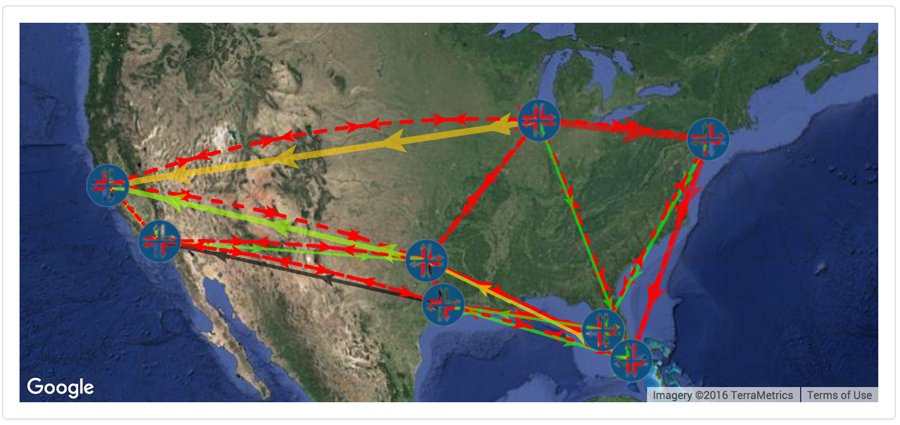
Challenge #1: Managing complexity
Large number of heterogeneous devices
Multiple layers of protocols
How can operators process information at this scale?

Slide 4
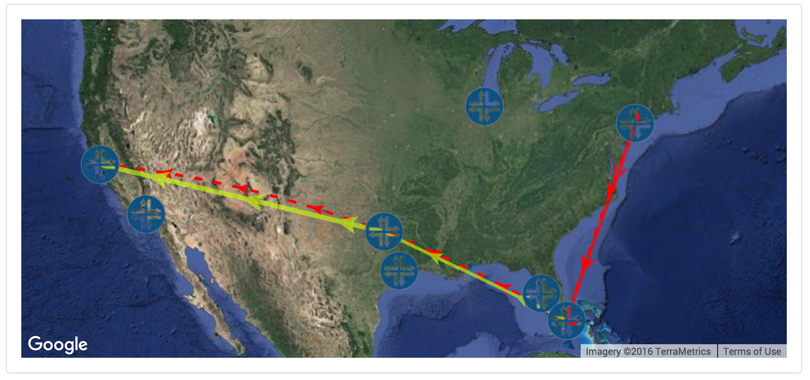
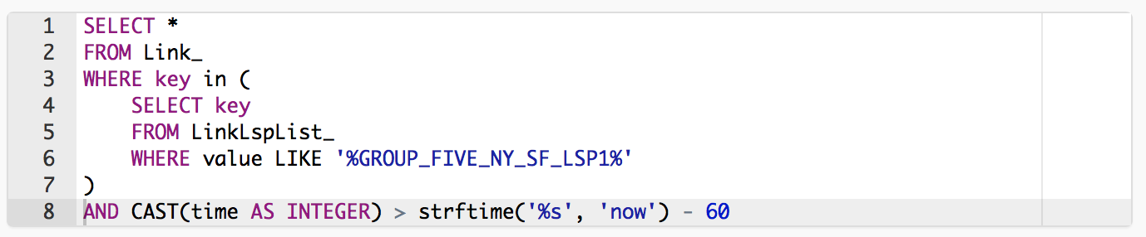
Solution #1: Interface with DevOps
Handling flexible management queries
Designed for DevOps
SQL interface for managing network states
Is this LSP tunnel traversing a hot link?

Slide 5
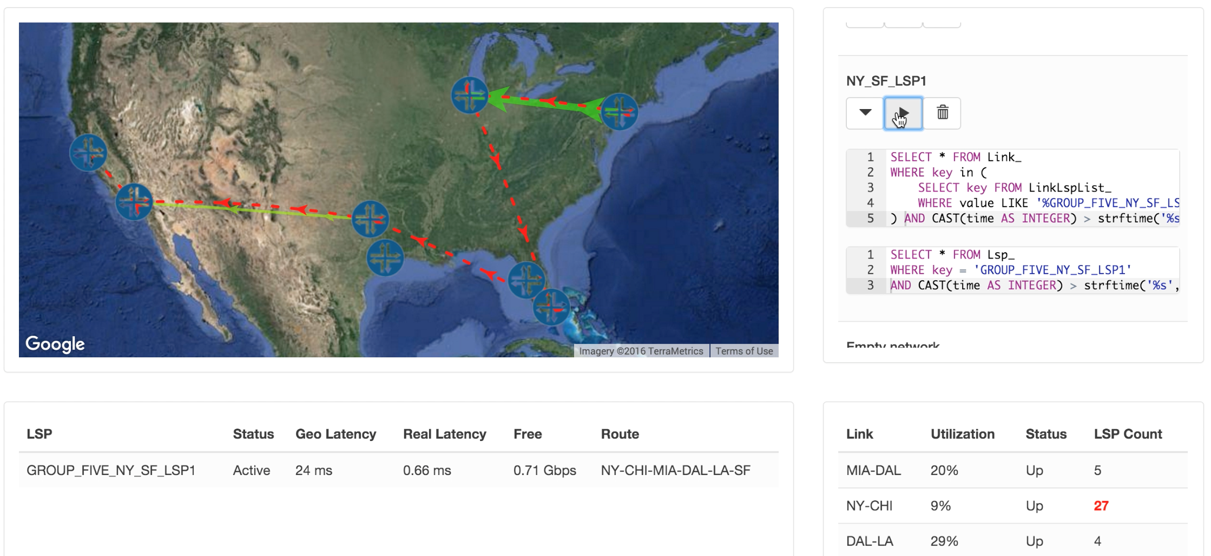
Demo #1: Using SQL for network diagnostics
Example #1: drilling into the network (#1-1, Yang)
Example #2: diagnosing LSP detour (#1-2, Yang)
Recap: managing network complexity by
programmatically interfacing with DevOps

Slide 6
Challenge #2: Handling chaos
Tunnels must be real-time and/or have high-throughput
Failures / congestions are hard to predict

Slide 7
Solution #2: Adaptive routing + TE
Measuring and probing network conditions
Assigning priorities to different tunnels
Adaptively rerouting tunnels
Combining with traffic engineering

Slide 8
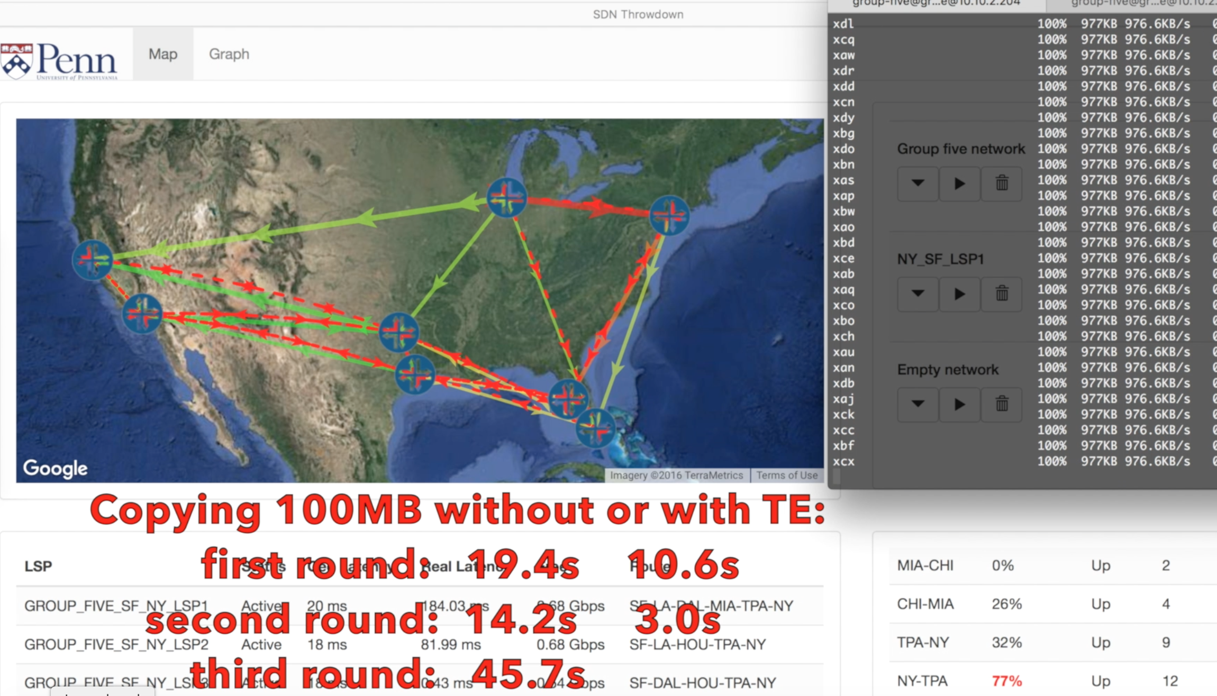
Demo #2: Adaptive routing + Traffic engineering
Example #1: fast rerouting video traffic around failures (#2-1, Yang)
Example #2: spreading traffic across tunnels adaptively (#2-2, Yunchen)
Recap: handling chaos in the network by
rigorous engineering multiple components

Slide 9
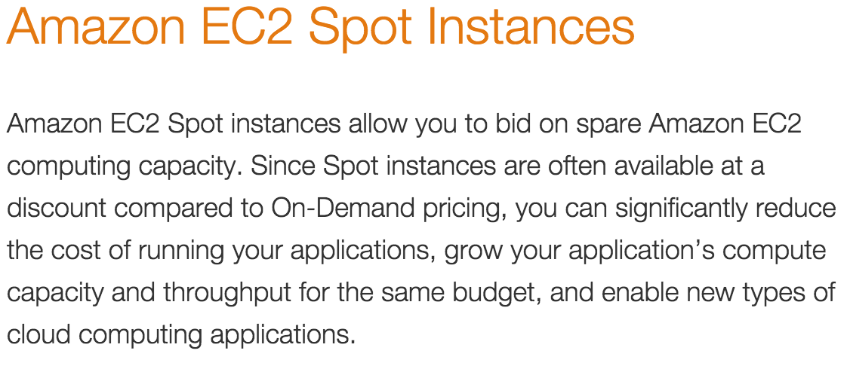
Challenge #3: Delivering more value
Customers can leverage information from the network
Example: on-demand service in other industries

Slide 10
Solution #3: Interface with customers
Pricing network resources adaptively
Applications can adapt to changing prices

Slide 11
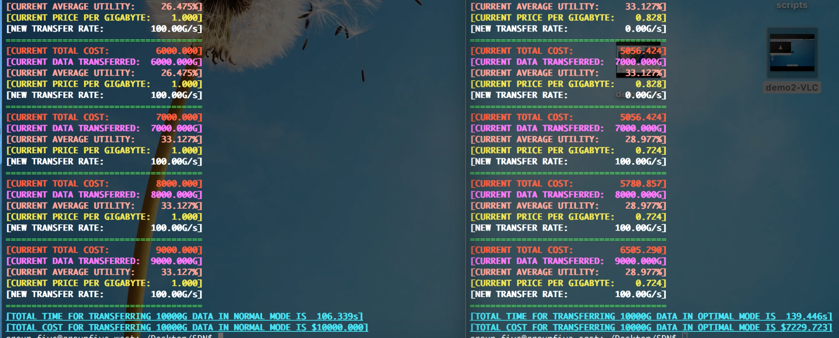
Demo #3: Delivering more value
Example: cheaper backup through network awareness (#3-1 Yunchen)
Recap: delivering value by
programmatically interfacing with customers

Slide 12
Summary
Code: https://github.com/wuyangjack/sdn-throwdown
Team: Penn-Defined Networks
Motivation: building the next WAN
Managing complexity by interfacing with DevOps
SQL interface that can build flexible monitoring and diagnostics
Example: drilling into the network, diagnosing LSP detour
Handling chaos by rigorous engineering
Measuring and probing the network
Choosing the right tunnel for the right application Combining traffic engineering and adaptive routing
Example: fast rerouting, adaptively spreading traffic
Delivering value by interfacing with customers
Helping customers building network-aware applications
Example: users rely on pricing API to cut costs
Live demo? Questions?

